Slide 1
Computer Graphics ECSE-4750 FALL 2015
CLASS 9

Slide 2
Class
Homework 4
Term Project
Some last thoughts
Different uses of computer graphics
Information visualization
Design
Games & Movies
Final words

Slide 3
Homework 4
Textures are very good, use your code from the in class challenge and textures to the Hw4 code.
Add code to interpolate texture coordinates for each state
Add one texture and reuse across all the geometries
Each state will “cut” themselves out of the entire image.
Try turning off some states
(Hint: To open local files you can turn off Chrome file security with the command line option: --args --disable-web-security, just remember to close the browser when finished)
(Or use Firefox ;)

Slide 4
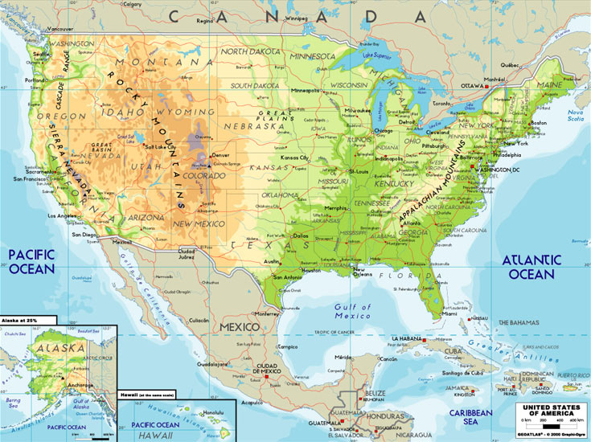
Texture coordinate generation
Interpolate on the geometries real world coordinates and find the appropriate texture coordinate
Previous example nice for simple translation
How to map to real world
Pixel: (611, 439 111)
Coord: (-75, 45)
Width: 735 Height: 550
Pixel: (84, 133 417)
Coord: (-120, 20)

Slide 5
Term Project
13 Teams
You will think of, implement, and document a program relating to graphics. It must demonstrate both graphics input and output; other than that it must only be legal and ethical.
Next week each team will have 10 minutes to present and demo their project
In the real world you will get about 2 minutes to capture peoples attention
This is good practice, keep me from napping during your presentation

Slide 6
Some last thoughts

Slide 7
What we can do now
Create basic 3D web applications
can integrate with other HTML5 packages
Work with event-driven input
Use a variety of texture-based methods
Make use of off-screen rendering

Slide 8
What we haven’t covered
More OpenGL capabilities
Modeling
Alternate renderers
Integration with Web
Where are things going

Slide 9
What’s in desktop OpenGL
Much more control and many more options
Geometry,Tessellation and Compute Shaders
Level of Detail (LOD)
1-4 Dimensional Textures
Many more texture options
Vertex Array Buffers
Occlusion Queries

Slide 10
What should we expect soon in APIs
Movement of more desktop OpenGL features to ES and WebGL
WebCL 1.0 released March 2014
ES 3.0 and ES 3.1
ECMA 6 Script draft (new version of JS)
Many JS variants such as Coffee Script

Slide 11
The Players have Changed
Originally hardware and software was dominated by the scientific and CAD communities
SGI key for both hardware and software
OpenGL developed by SGI
With PCs and graphics cards leadership moved to Microsoft and game users
DirectX
Video Toaster

Slide 12
Players Have Changed
Development of GPUs
Nvidia, AMD and Intel dominate
OpenGL makes a comeback
Cg (Nvidia) leads to GLSL
Interactive games control direction of hw and sw
Web and smart phones
Google, Mozilla, Nokia and others dominate software
ARM dominates smart phone chips

Slide 13
Advanced Topics
Level of Detail (LOD)
Image based rendering
Light field rendering
Ray Tracing (CS 413)
Volume Rendering
Point Clouds
Particle Systems
Information Visualization

Slide 14
What about Games?
Need more courses
Digital Storytelling
Game AI
HCI
Real-time graphics

Slide 15
Supercomputing
Fastest supercomputers use GPUs for floating point operations
GPGPU
OpenCL/WebGL
Compute shaders
Low power is a major issue
Exascale machine will require 20MW
Intel vs ARM?

Slide 16
More Visualization

Slide 17
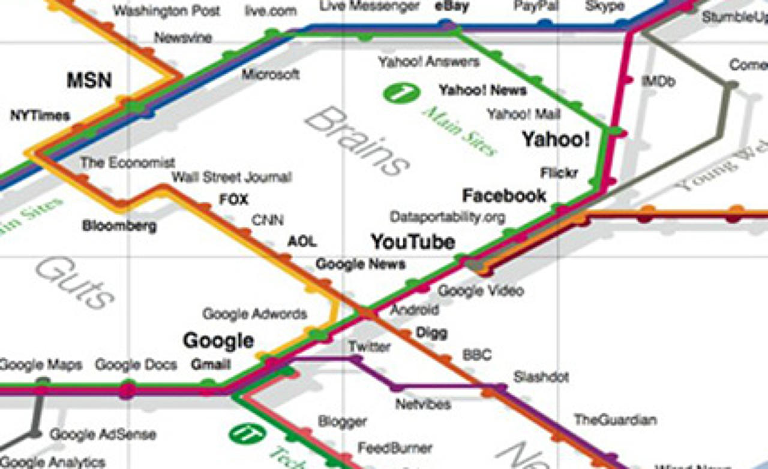

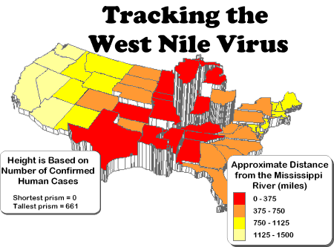
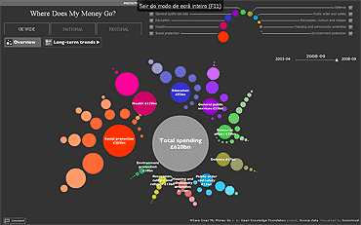
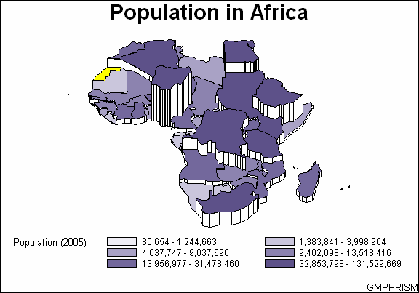
Information Visualization

Slide 18
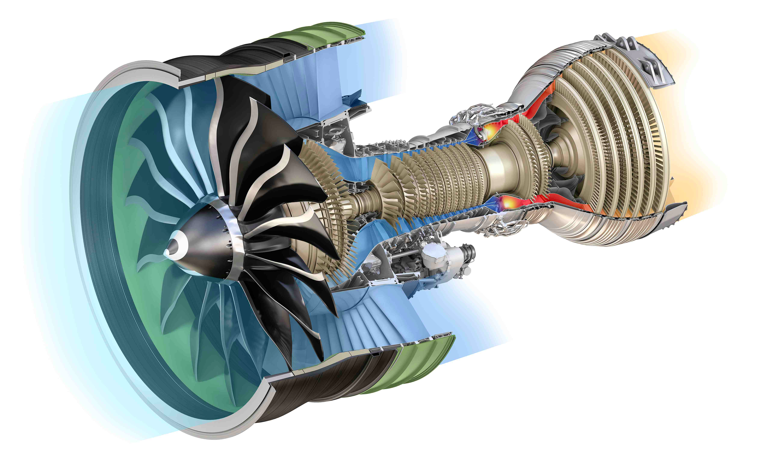
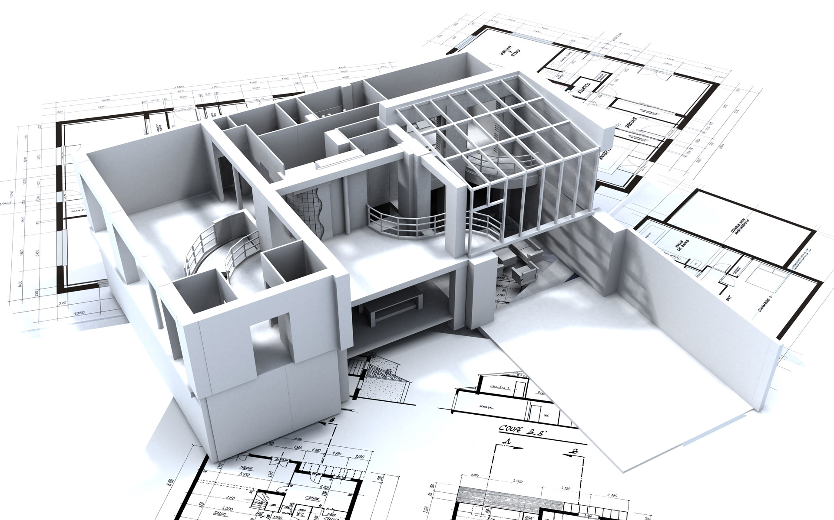
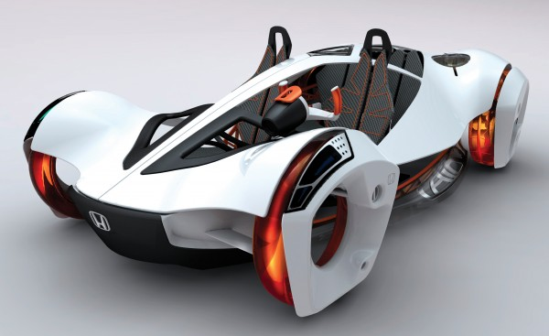
Design

Slide 19
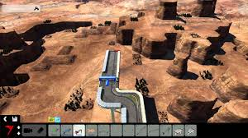
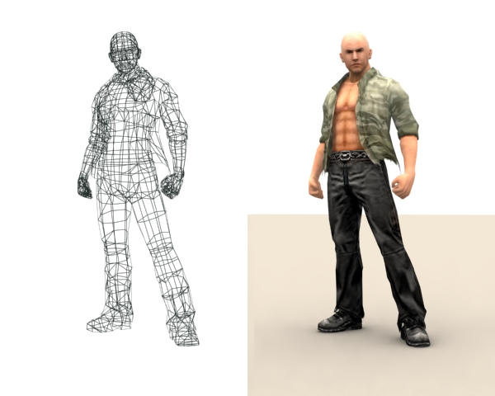

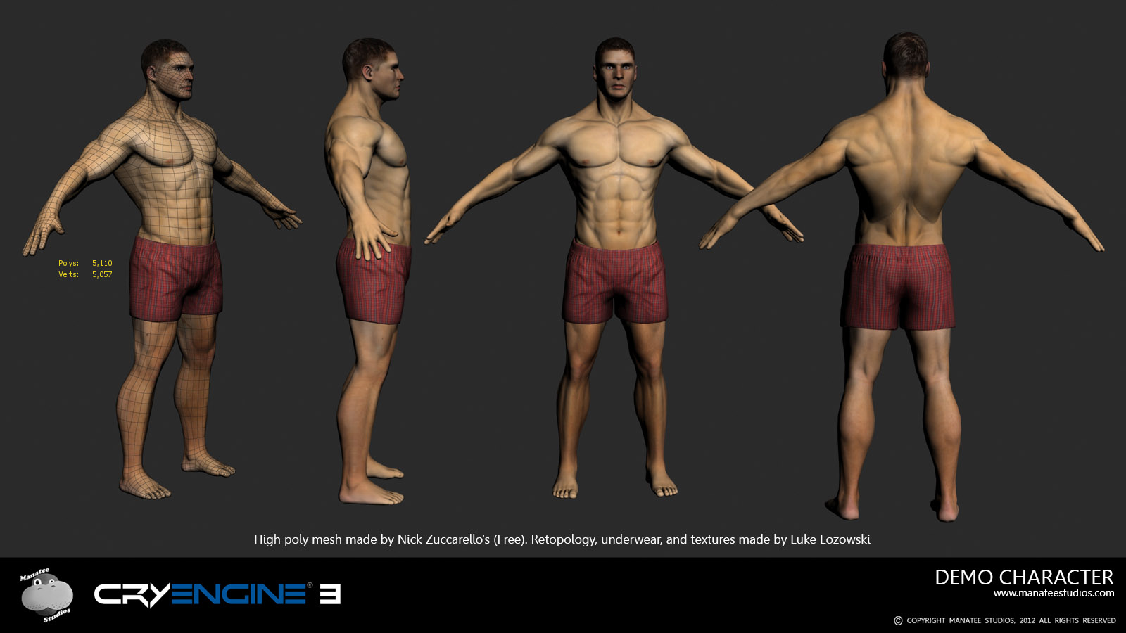
Games & Movies

Slide 20

Vtk
Visualization ToolKit

Slide 21
Final words
I hope you had fun
If there is anyhting I can do to help you in the future please ask
Thank you!

